Slide 1
Impact of Occupational Therapists in the Workforce
Karin Orman
Karin.orman@cot.co.uk
@KarinOrmanOT

Slide 2
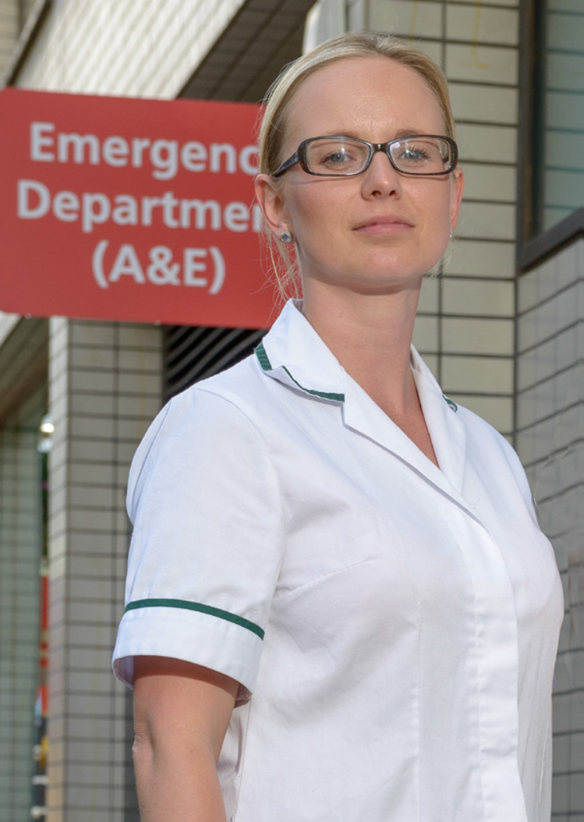
Occupational therapy
improves health &
wellbeing
through participation
in occupation.
Notes:
How can you explain occupational therapy to the public using this definition?
Does this work for you?
My role is to help you improve your health by participating in occupation- getting back to what you want or need to do day to day.

Slide 3
What supports/ensures your wellbeing?
Occupation shapes our identity, our feelings of self worth and our occupations connect us with people- it is central to our relationships.
Most people adapt their occupations to suit their needs and interests throughout a life course but for some disability, illness, frailty or trauma and/or crisis makes this challenging.
What occupations would you not want to give up?
Notes:
Activities that allow us to live independently and give us a sense of identity
This could be anything from essential day-to-day tasks, such as dressing or cooking, to the things that make us who we are—our interests, hobbies and relationships.
Look up definitions for activity and you will see it defined as something someone does. Being active simply means moving about or showing involvement.
With these definitions in mind we can expect everyone to be active – it is not just for the young and fit and everyone can and needs to engage in activities.

Slide 4
Empowering people to live their lives
Notes:
Activities that allow us to live independently and give us a sense of identity
This could be anything from essential day-to-day tasks, such as dressing or cooking, to the things that make us who we are—our interests, hobbies and relationships.

Slide 5
College of Occupational Therapists’ Campaign Programme
Keeping people out of hospital
Reducing pressure on primary care
Addressing over reliance on social care

Slide 6
Colchester Older People’s Team Aims:
• Work with those patients identified through the GP Admissions Avoidance list to identify if, by working differently in a proactive rather than a reactive way, the project can reduce the likelihood of hospital admission.
• Begin to understand the different roles organisations are working across community health and primary care by working with patients and holding “conversations” that reduces the likelihood of a move into more formal (often long term) health or social care services
• Improve and increase understanding across the different agencies to develop a multi-disciplinary approach i.e. involving the most appropriate professional, family members & community groups to support a patient centred approach
• Increase the number of connections made for people as early as possible so they contribute to their own health and social care needs
Adopt the “Good Lives” principles.
Notes:
Activities that allow us to live independently and give us a sense of identity
This could be anything from essential day-to-day tasks, such as dressing or cooking, to the things that make us who we are—our interests, hobbies and relationships.

Slide 7
Good Lives Principles:
•Good Lives uses P4C’s model of 3 “real” conversations with people at different levels.
Each level has a specific set of rules, to replace the traditional ‘contact then assessment for services’ approach.
Level 1 Outcome: To get people connected so that they can continue to live independent inclusive lives. This is about keeping the person able, independent, active and self-managing.
Level 2 Outcome: To regain independence and control. For people who are in crisis, who without some support will be at serious and imminent risk of losing independence and control over their lives..
Level 3 Outcome: In control of your life. This person has had every opportunity to live an independent life without ongoing support through conversations one and if necessary two, but this has been proved not to be
sufficient.
Notes:
Activities that allow us to live independently and give us a sense of identity
This could be anything from essential day-to-day tasks, such as dressing or cooking, to the things that make us who we are—our interests, hobbies and relationships.

Slide 8
Outcomes:
Feedback - greater confidence and felt more able to manage their own health and care needs.
For family members and carers - their family member had increased choice and control over their lives.
The most significant benefit and cost saving of working through the MDT is the reduced need for multiple assessments. Although hard to define, there are transactional cost reductions associated with improved multi-disciplinary and organisational working.
= A shorter customer journey.
Benefits of preventing emergency admission or attendance at GP has reduced pressure on these systems.
Notes:
Activities that allow us to live independently and give us a sense of identity
This could be anything from essential day-to-day tasks, such as dressing or cooking, to the things that make us who we are—our interests, hobbies and relationships.

Slide 9
Sport for Confidence:
Sport for Confidence encourages people with and without learning disabilities to participate together. This approach is also championed by Special Olympics through their Unified Sports®’ programme which was inspired by the principle that ‘playing together is a quick path to friendship and understanding
Research shows that people with a Learning Disability remain one of the most excluded groups in sports and not only are participation rates low, but they are falling.
1. Support leisure centres and other mainstream sports groups and venues to deliver the reasonable adjustments they need in order that people with learning disabilities, Asperger's syndrome, mental health difficulties.
2. Mentor, train and support coaches to adapt their behaviours and professional practice to become more inclusive, accessible and
person focused.
Notes:
Activities that allow us to live independently and give us a sense of identity
This could be anything from essential day-to-day tasks, such as dressing or cooking, to the things that make us who we are—our interests, hobbies and relationships.

Slide 10
The occupational therapists contribute specialist knowledge and work closely with both the leisure centre staff, coaches and community learning disabilities teams to ensure that the needs of the clients are met and that there is regular communication, reflection and mentoring support.
There are now over 8 sessions delivered per week (trampolining, multi sports, cricket, boccia, New Age Kurling, athletics, parkour, netball, tennis and fencing). The group is comprised of both men and women aged between 16 – 55.
Notes:
Activities that allow us to live independently and give us a sense of identity
This could be anything from essential day-to-day tasks, such as dressing or cooking, to the things that make us who we are—our interests, hobbies and relationships.

Slide 11
Results and evaluation
- 100% identified that attending Sport for Confidence had given them the opportunity to be more active and try new things and the vast majority identified that their health and wellbeing and confidence had improved.
- 100% of carers reported seeing the confidence of the person they support improve and gave opportunities to meet new people and make friends.
- 65% of clients have gone on to join other local clubs, sports and activities since attending SFC
Return on investment:
There is a customer charge of £2.20 to attend each session.
Costs of providing the service for one year in one setting/area = £25,000 per area
For (300 x 12) = 3,600 unique visits per year = £6.94 cost per visit
Less the customer charge of £2.20 = £4.74 per visit
NICE public health guidance on the management of long-term sickness and incapacity for work provides cost information on workplace physical activity intervention involving 10 sessions of physiotherapy/ physical activity and 10 sessions of cognitive behaviour therapy gives a total cost of £860 for the total 20 sessions = £43 per session.
Notes:
Activities that allow us to live independently and give us a sense of identity
This could be anything from essential day-to-day tasks, such as dressing or cooking, to the things that make us who we are—our interests, hobbies and relationships.

Slide 12
Occupational Therapy:
trained and focused on enabling people to live at home and to live well regardless of health or social circumstances.
Five Year Forward View aims to remove the “artificial boundaries” between hospital and community services and between health and social care. As a profession those boundaries do not naturally exist but are imposed on the profession by service structures.
Commissioners and providers should fully utilise occupational therapy staff to make the most of a profession that inherently:
• understands this new model of care;
• can support the adoption of a person centred ethos and;
• can embed self management principles across health and
social care
Notes:
Activities that allow us to live independently and give us a sense of identity
This could be anything from essential day-to-day tasks, such as dressing or cooking, to the things that make us who we are—our interests, hobbies and relationships.

Slide 13
Challenges
Move from secondary services to primary and public health.
Implementing the Care Act – delivering on prevention and wellbeing. Accessing communities as well as the home.
Re-investing on building relationships.
Challenging ageism and society’s preconcieved ideas/beliefs.
Notes:
Activities that allow us to live independently and give us a sense of identity
This could be anything from essential day-to-day tasks, such as dressing or cooking, to the things that make us who we are—our interests, hobbies and relationships.

Slide 14
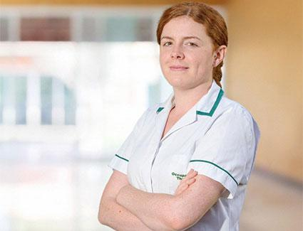
College of Occupational Therapists’ Campaign Programme
Visit:
www.cotimprovinglives.com
Keeping people out of hospital
Reducing pressure on primary care
Addressing over reliance on social care

